Slide 1


Bring AI to your data
Dell Generative AI Solutions

Slide 2

What are leaders telling us?
There’s already a lot of usage
91%
71%
reported using Generative AI in their lives in some capacity
indicated that they’ve used it for work
We believe there is a lot of potential with GenAI but there are serious risks that need to be considered. We are using GenAI but very cautiously.
– IT Manager
Notes:
Recently we polled 200 business and technical leaders asking about what they’re experiencing and where they are at in their journey. What was interesting is the extent of which Generative AI has already made its mark on users. 91% reported they’ve used GenAI in some capacity at home, but more importantly an incredible 71% are already using it at work. Furthermore in other research from Techanalysis based on a population of 1000 respondents we see that only 8% have a formal policy drafted at this time. This means it’s a good chance that a large portion of that 71% is using these tools without guidance from their organization, or what we might call participating in Shadow AI.
And we see the concern leaders have. One of the IT directors said explicitly there’s a lot of potential, but also serious risks. We need to be cautious here. This is the backdrop leaders have to face as they make their plans.

Slide 3


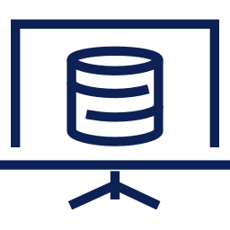



It is critical IT responds quickly to the opportunity
The excitement for consumer-grade GenAI has given way to businesses moving forward quickly with their own data
54%
78%
of organizations are either already using GenAI or planning to in the next 12 months¹
say training on enterprise data
is important²
82%
39%
prefer a primarily
on-premises or hybrid GenAI model³
say one of their biggest challenges is the employee expertise/skills gap²
ESG Report - Beyond the GenAI Hype: Real-world Investments, Use Cases, and Concerns, August 2023 (N= 790)
A New Beginning: Generative AI in the Enterprise – TECHnalysis Research Survey Report, May 2023 (N=1000)
Dell Technologies Generative AI Pulse Survey, August and September 2023, www.dell.com/GenAIPulse (N=500)
Notes:
Now its important to note as a leader in technology you’re going to have to move quickly on this opportunity. The excitement and exuberance for this technology has been off the charts. Consumer-grade generative AI has really struck a cord with users. Yet it’s ill equipped for organizations needs. Using a public LLM is similar to using an encyclopedia to solve very targeted issues. While some use cases can benefit from the generalist knowledge scraped from the internet. Where we see the most excitement brewing is in the ability to use an organization’s own data to power GenAI.
54% of organizations are either already using GenAI or planning to in the next 12 months. Meaning the time for IT to drive effective change and support the organization is now.
Yet 39% of organizations are saying one of their biggest challenges to embracing Generative AI is the employee expertise/skills gap. Which means moving quickly and getting this sorted out will require overcoming this barrier.
Given 78% say training on enterprise data is important finding a way to integrate Generative AI and make data available for use with these systems will be key.
And finally, maybe counter to what you might have expected the preference is largely to do this on-premises or in a hybrid model. 82% of organizations surveyed in the Dell Generative AI Pulse Survey noted they preferred being largely in the data center or in a hybrid model based on the data and its sensitivity.

Slide 4

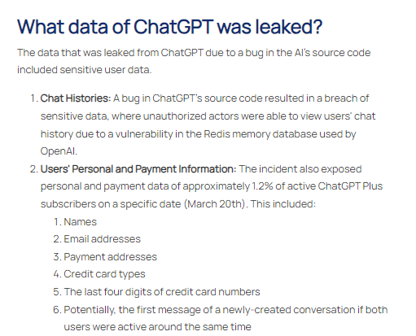
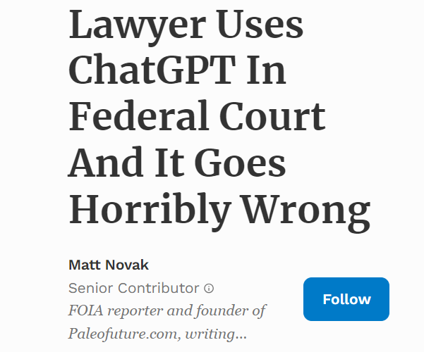
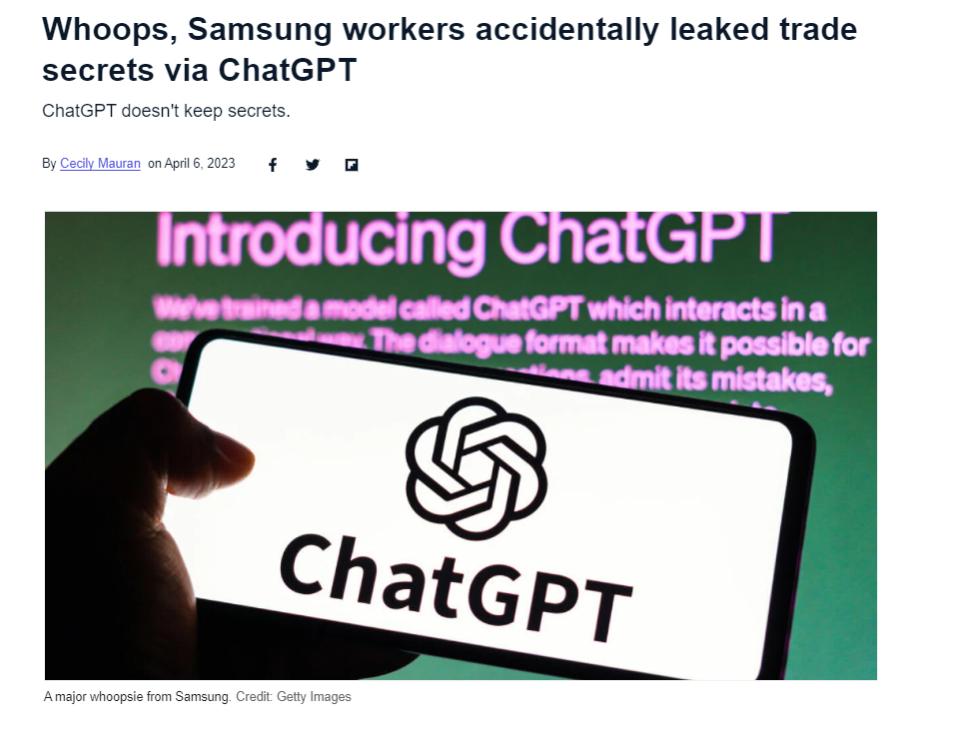
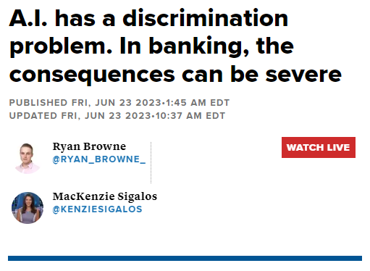
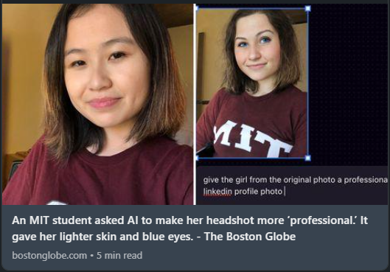

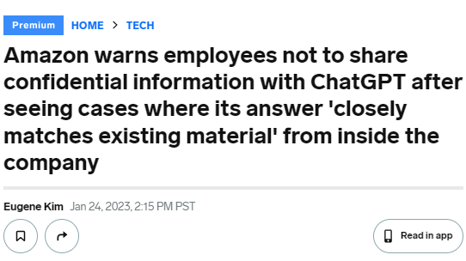

Risks of getting GenAI wrong
01
02
03
04
05
06
07
Don’t make the headlines
Intellectual property loss
Data leakage
Privacy issues
Compliance violations
Credibility & integrity risks
Bias
IP infringement
Notes:
Now what's driving some of this behavior? There are some unique challenges with Generative AI which can even be more pronounced in public cloud hosted models. Now there is no denying Public Cloud plays an important role in modern IT, but the way Generative AI works is a little different than what we’re used to with Infrastructure as a Service. With IaaS you still held the security keys meaning you could restrict access. With Generative AI its open and learning by default. Now the cloud vendors are introducing some steps to cut down on this risk such as offering private instances of OpenAI where the machine is said to not be trained on your data and 3rd parties won’t have access to it, but those tools still have a few data sovereignty issues. These data sovereignty issues I speak of are that the data is still readable, many of these services will store your data for at least 30 days, and if an incident occurs authorized employees can access your data and prompts. This opens up a lot of new risks to consider such as a governmental entity requesting to see your data in pursuit of a criminal or anti-trust type investigation, without your knowledge, or a trade-secret being exposed to eyes outside of your organization.

